Slide 1
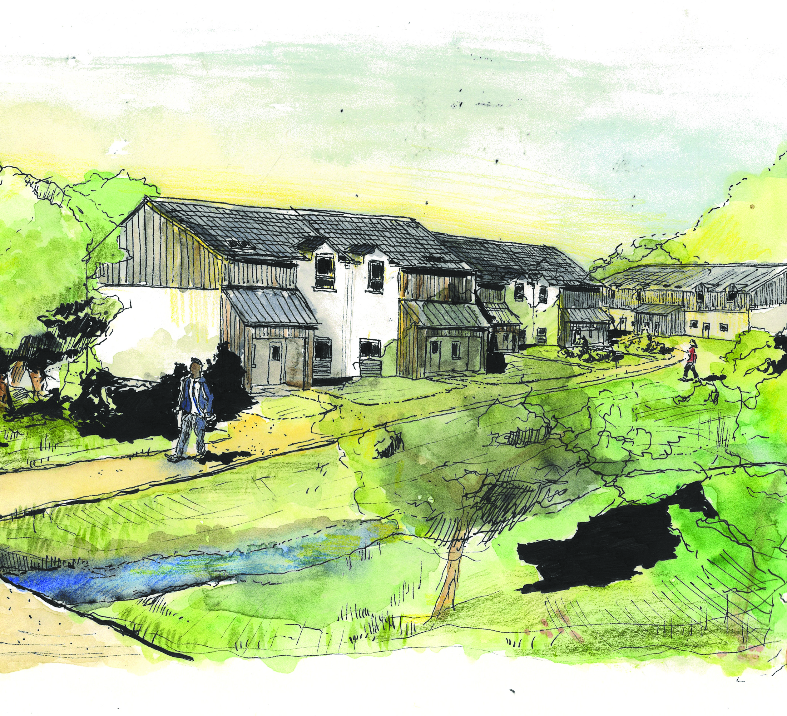
C o r r a n r è I l e a b e r f e l d y affordable, sustainable, community-led housing
catoe/brown
architecture & landscape studio
Corran Rèile Presentation 08/11/2025

Slide 2
RIBA Chartered Practice based in Inverness with a studio in Portree, led by co-founders Jamie Catoe & Edward Brown.
Committed to community-led, sustainable design with projects rooted in Highland heritage & ecology.
Collaborative approach delivering affordable housing & place-sensitive design in partnership with local organisations.
Contact us: studio@catoebrown.com
About c/b
catoe/brown
architecture & landscape studio
Corran Rèile Presentation 08/11/2025

Slide 3
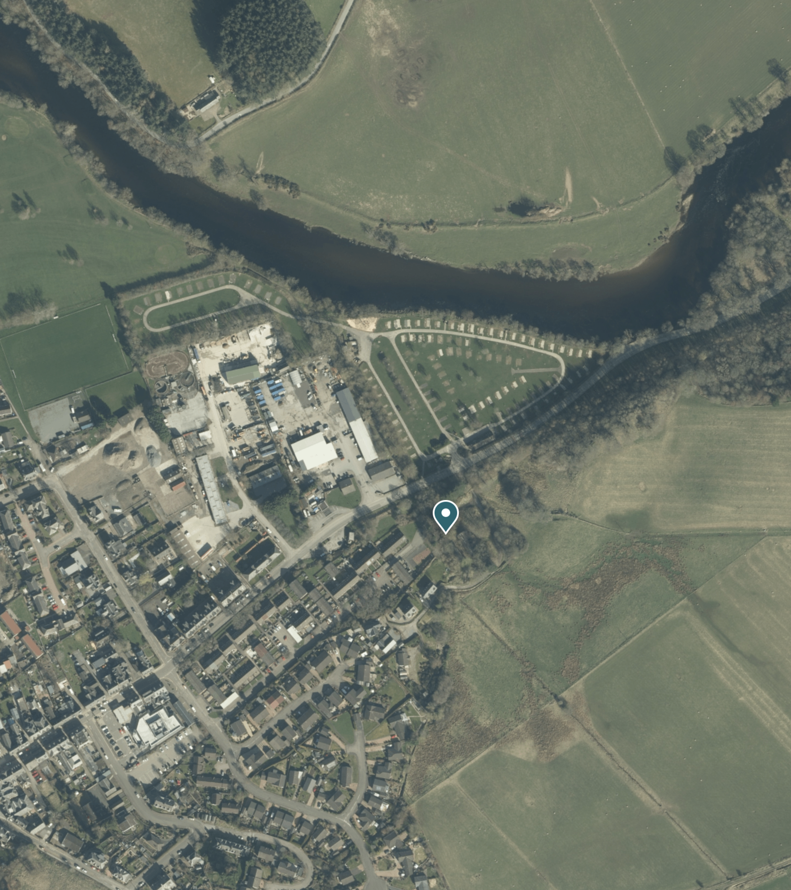
What: Brownfield redevelopment offering a sustainable alternative to greenfield sites.
Where: Walkable location within a 20-minute neighbourhood, close to shops, schools, and transport.
Why: Community-owned site in a quiet residential setting, enabling local-led housing delivery.
Former Slaughterhouse Site
catoe/brown
architecture & landscape studio
Corran Rèile Presentation 08/11/2025

Slide 4
Access: Access via Appin Place with relocated services gate; shared parking near track and rear gardens for easy access.
Houses: Eight homes (4 cottage flats, 4 houses) with rear gardens and landscaped communal areas to foster community.
Landscape: Native tree planting for screening and external treatments to enhance privacy and sense of place.
Development Proposal
catoe/brown
architecture & landscape studio
Corran Rèile Presentation 08/11/2025

Slide 5
Site Strategy
Community-Focused Design: Compact layout with shared parking, active street frontage, and balanced density for privacy and amenity.
Sustainable Landscape: Integrated paths and green spaces, ecological planting, and water management through rain gardens and daylighted watercourse.
Affordable & Future-Proof Housing: Community-owned homes with energy-efficient features, local-led delivery, and layouts that foster a sense of place.
catoe/brown
architecture & landscape studio
Corran Rèile Presentation 08/11/2025

Slide 6
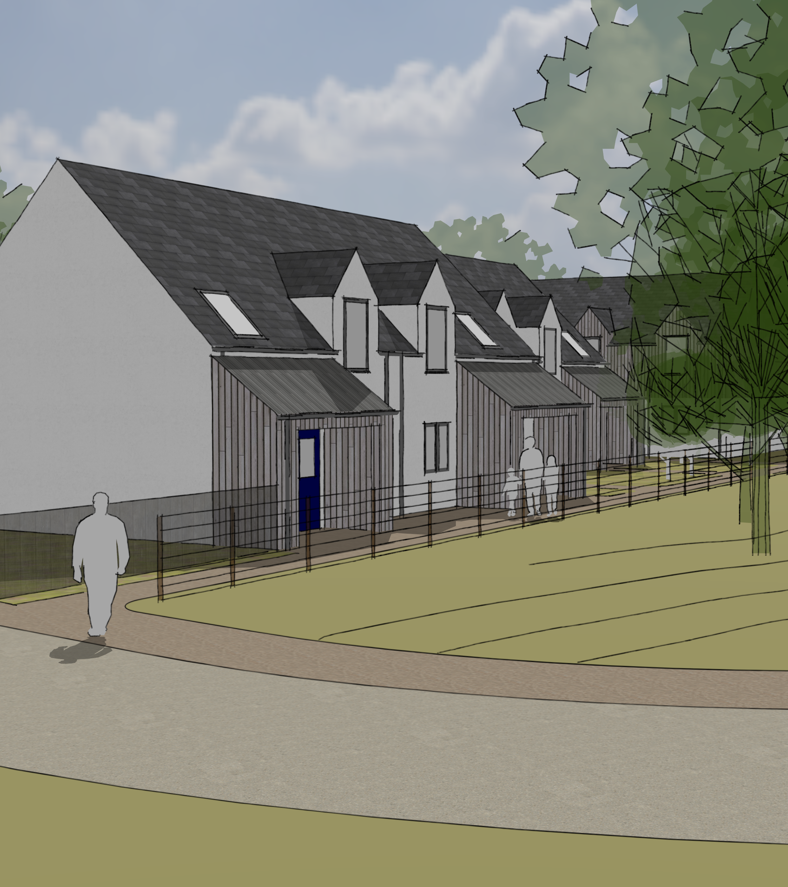
House Concepts
Four homes in a linear terrace (2×2-bed, 2×3-bed) with private entrances and modest gardens, complemented by shared landscaped areas.
Traditional forms with contemporary detailing; roof pitches and muted material palette harmonise with woodland setting.
Façades feature white render and vertical timber cladding, with durable slate and metal roofing for visual interest.
catoe/brown
architecture & landscape studio
Corran Rèile Presentation 08/11/2025

Slide 7
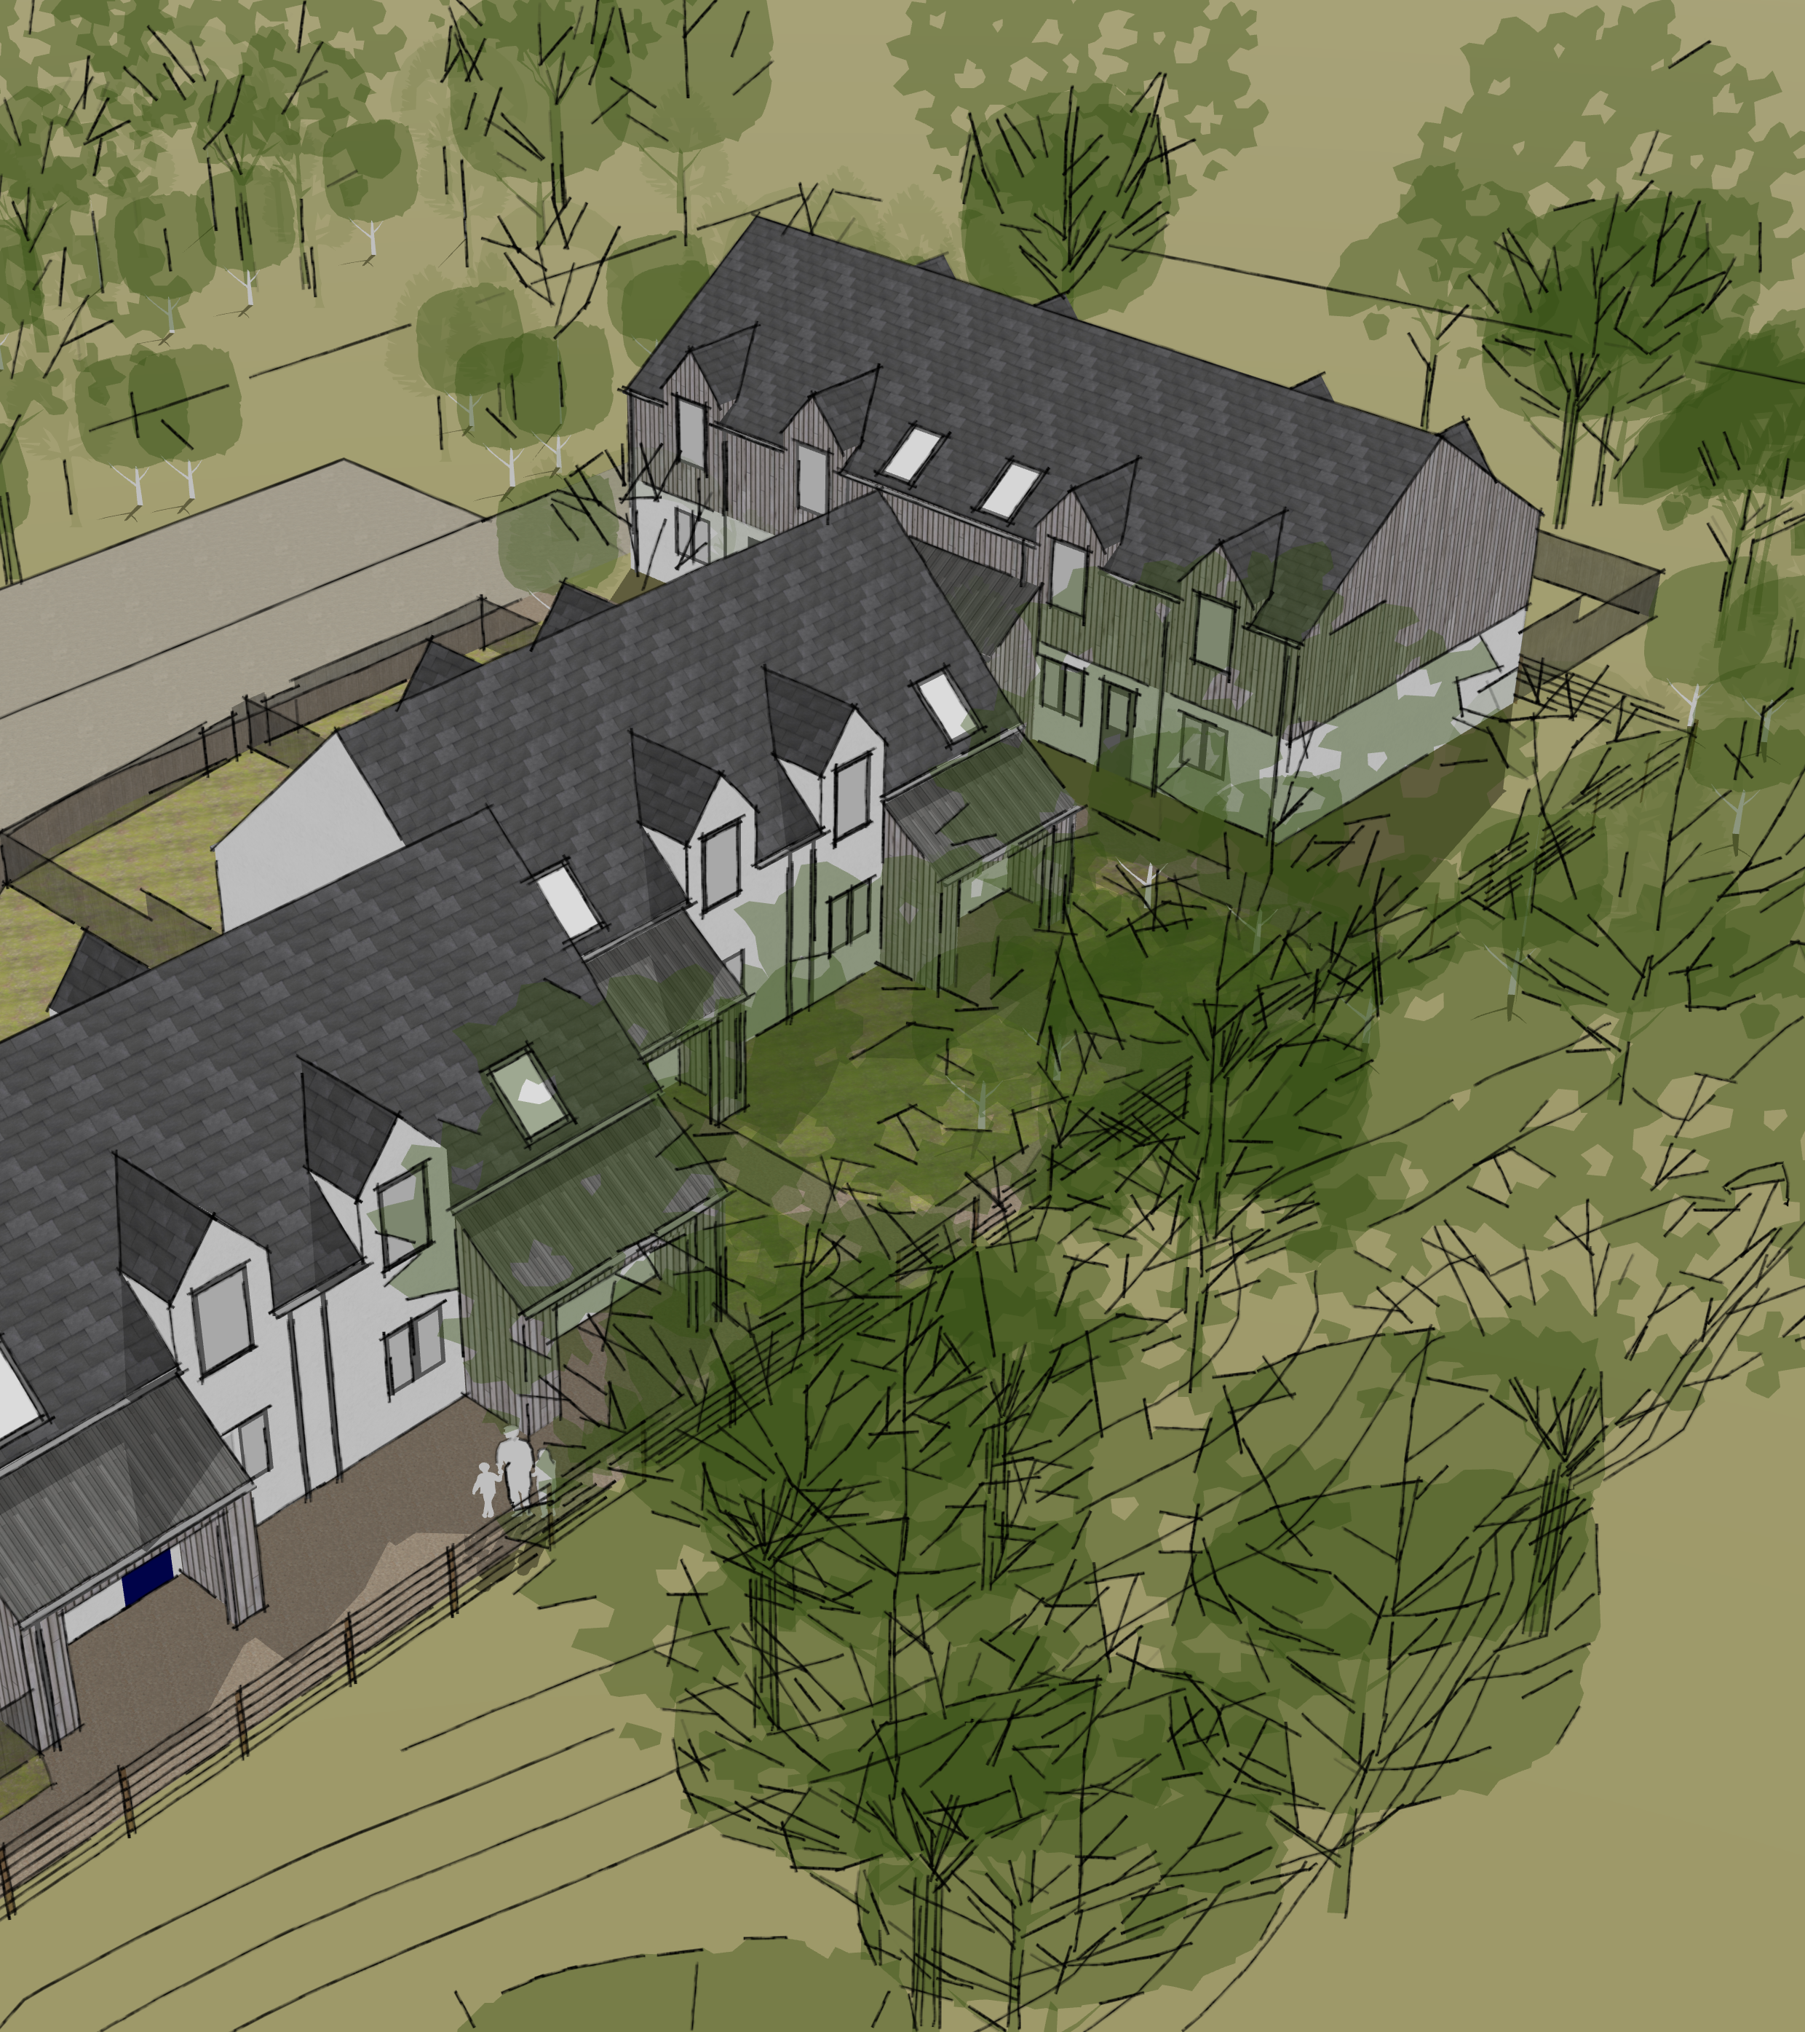
Two-storey paired flats with private entrances; ground floor prioritises accessibility, upper units offer extensive views.
Compact footprint with generous two-bedroom layouts & open-plan interiors for light & flexibility.
White render, timber cladding, and dark roofing harmonise with woodland setting for an integrated look.
Cottage Flat Concepts
catoe/brown
architecture & landscape studio
Corran Rèile Presentation 08/11/2025

Slide 8
Safe access via Appin Place for all users, with provision for emergency & service vehicles.
Privacy for existing residents through strategic new planting & screening.
Flood risk mitigation using sustainable drainage & site-specific measures; daylight existing culvert & new culvert under existing track to replace existing.
Central refuse store on A827 for convenient access by all residents.
Upgrade of existing play park (collaboration with PKC?)
Other Considerations
catoe/brown
architecture & landscape studio
Corran Rèile Presentation 08/11/2025

Slide 9
catoe/brown
architecture & landscape studio

