Slide 1
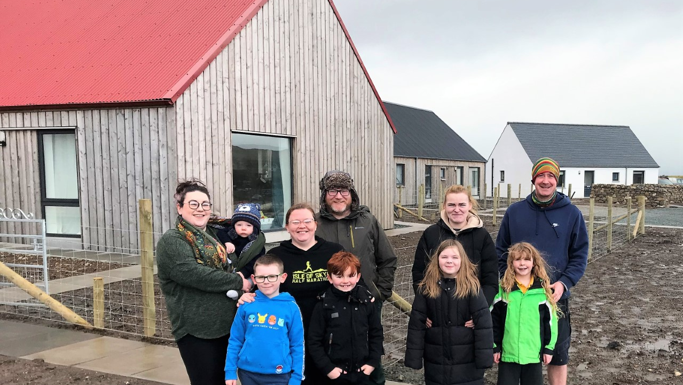

Sustainable Rural Futures​
25 years of community-led developments
John Forbes Community Led Housing Coordinator
john.forbes@chtrust.co.uk
www.chtrust.co.uk
@chtscotland
Communities Housing Trust is a Company Limited by Guarantee (SC182862) and a Scottish Charity (SC027544)

Slide 2
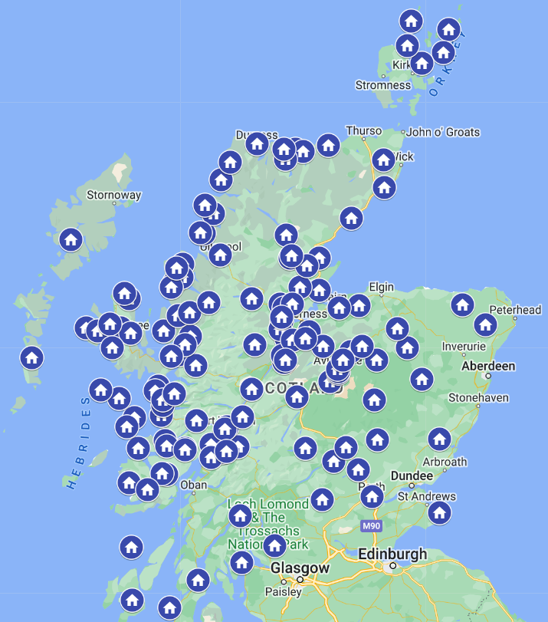

Where we work ​Some of our community-led projects across northern and central Scotland

Slide 3
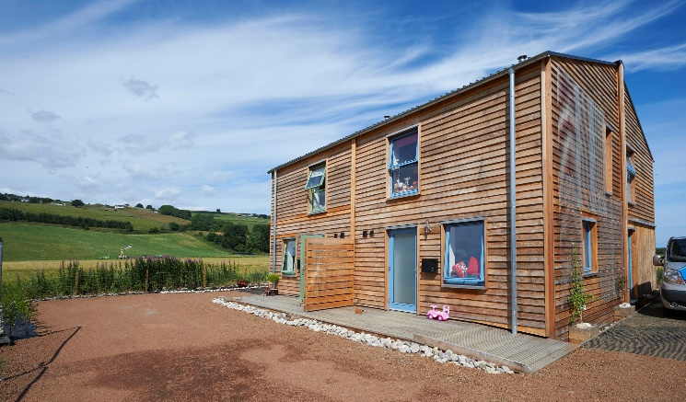
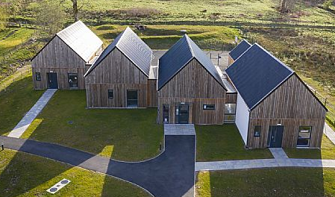
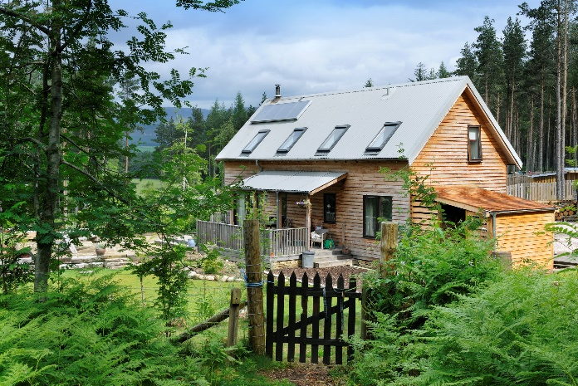
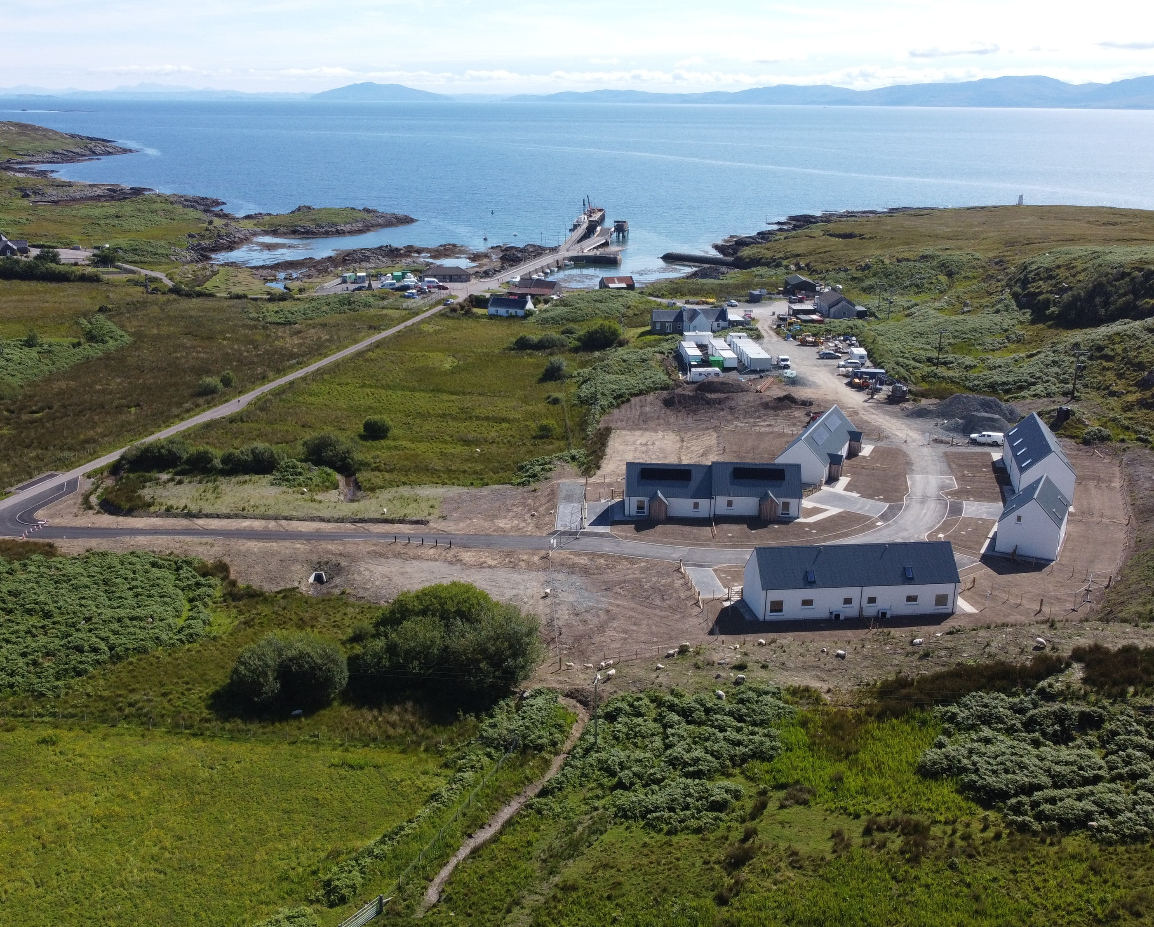
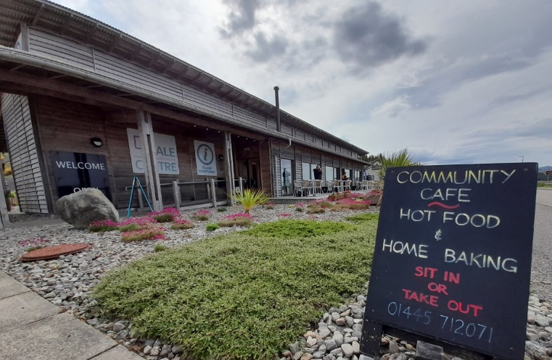
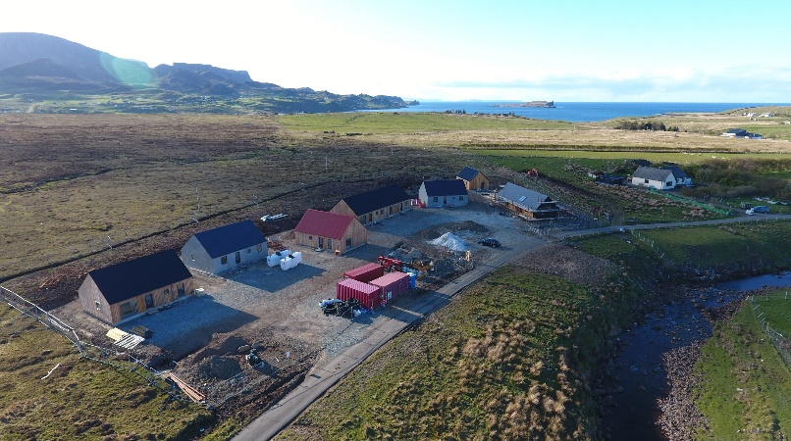
What we do
We are the leading organisation delivering community-led housing in Scotland
We tackle social inequalities, repopulation and rural regeneration
We bring together public & private stakeholders to provide community-led, affordable housing and accompanying facilities
We pioneer a range of housing tenures, financial and technical solutions to create sustainable futures for rural communities – including initiatives such as Long Lease, Rural Housing Burden and Woodland Crofts
Greener Homes / Rent To Buy, Fodderty
Strontian Community School Ltd.
Rural Housing Burden / Self Build
Cairngorms, low-cost home ownership
Staffin, NHS health centre
GALE Centre, Gairloch

Slide 4
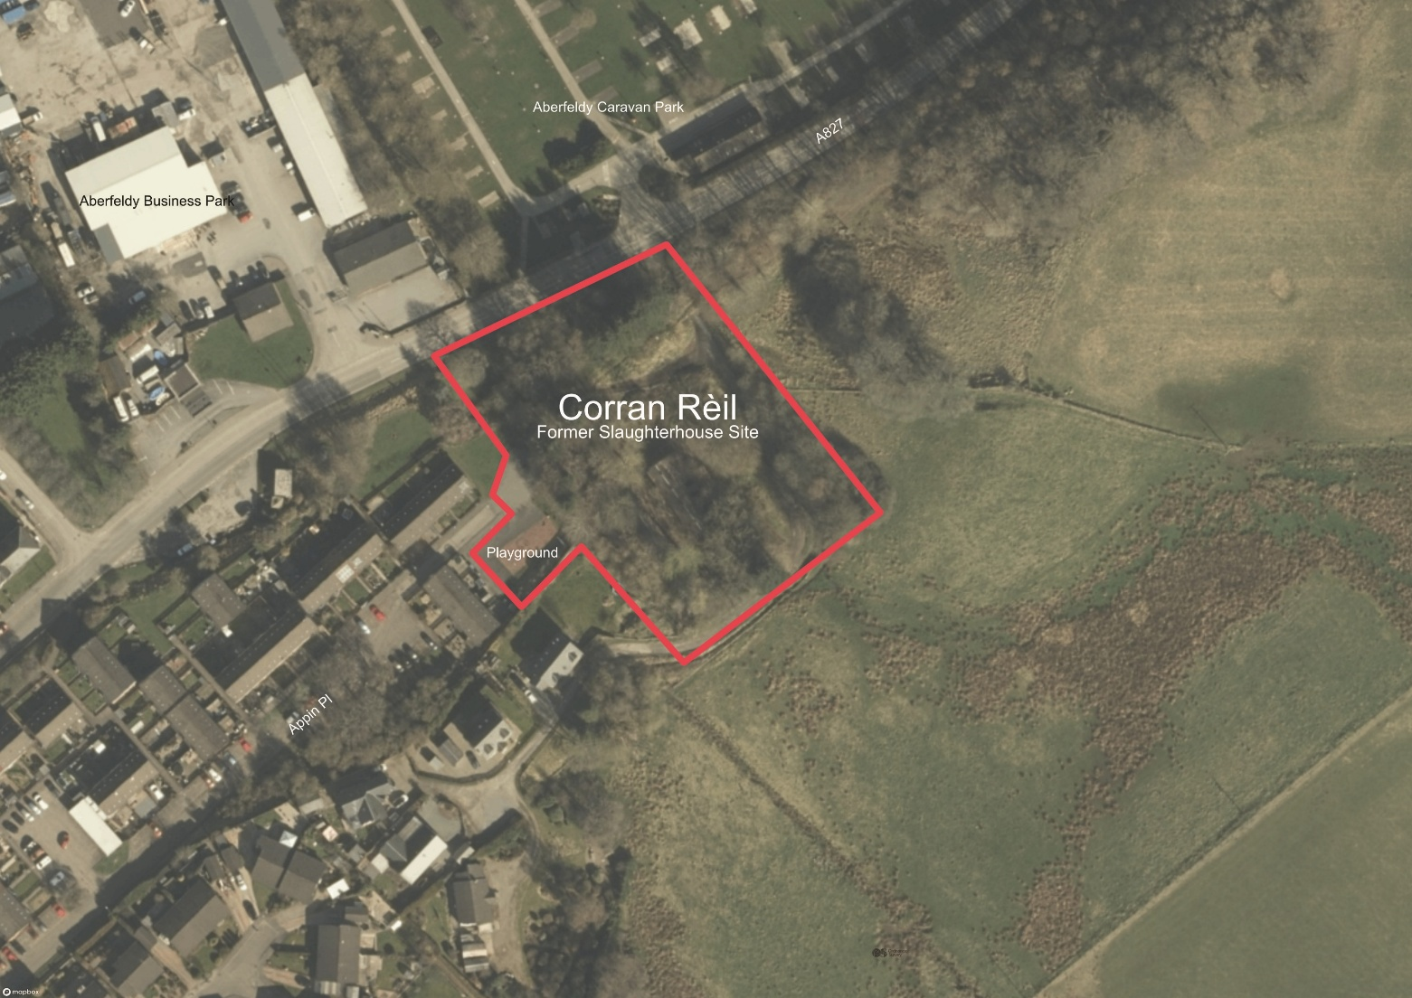
Our Role for Aberfeldy Development Trust
Acting as Development Agent: ​
Reviewing procurement and tender processes.
Secure funding for site acquisition.
Overseeing the design team and specialist consultants.
Business Planning and handling quotes.
Liaising with grant providers, including Scottish Government More Homes Division, Scottish Land Fund and Perth & Kinross Council.
Managing development activities.
Assessing requirements for feasibility studies.
Community and stakeholder engagement. Involving the community at key stages throughout process for input and feedback.
The proposed site in Aberfeldy
Notes:
Commissioned to work on around 150 community-led projects in total, with many more at earlier stages
This includes the 113 discounted properties with a RHB we provided in almost 40 rural communities and the 57 homes for rent in 30 communities

Slide 5
Community Housing Options
Community rent options:
Social rent equivalent.
Mid market rent.
Sales options:
Low-Cost Home Ownership (Discounted Sales). Protected by a Rural Housing burden.
Colonsay: a mix of affordable rent, LCHO, local worker and discounted self build plots

Slide 6
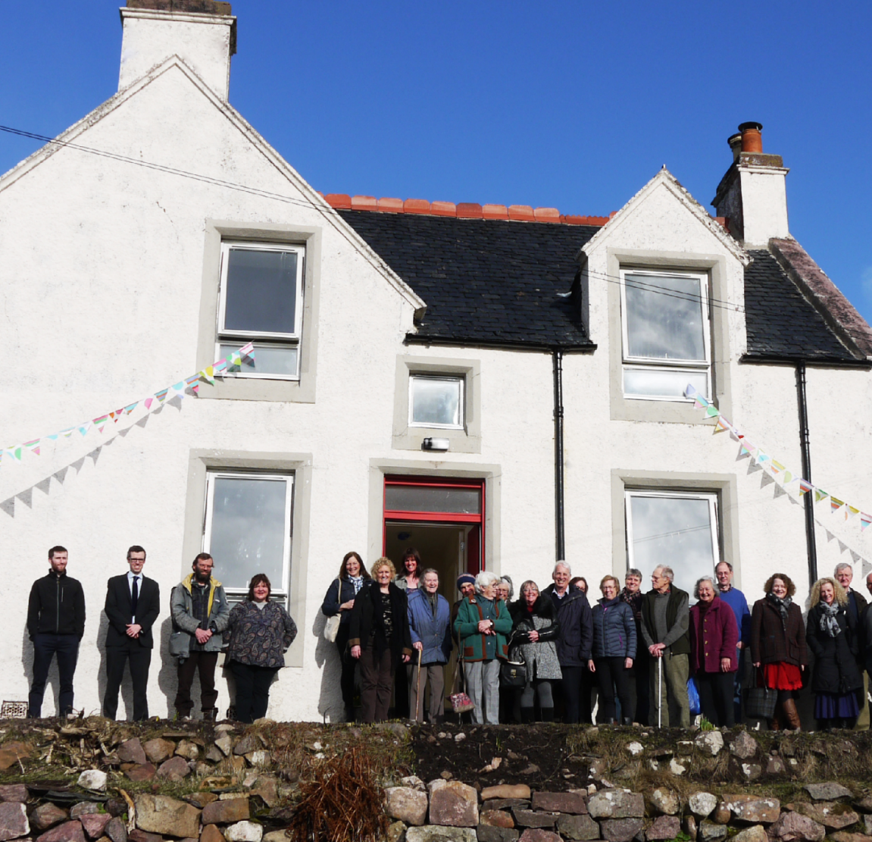
Community-led allocation policies
Applies to all Community Led Housing developments: Sales and Rentals.
BENEFITS:
Prioritises the needs of the local community based on:
People already living there, in insecure or unsuitable property.
The need to work locally.
Family connections.
Helps support:
Younger people to stay in their own community & contribute.
Businesses and service providers struggling to find accommodation for staff.
School rolls and services.
Older people able to stay in own community near family and friends support structures.
Ensures a diverse and sustainable community
Achiltibuie: renovation of community-owned former schoolhouse

Slide 7
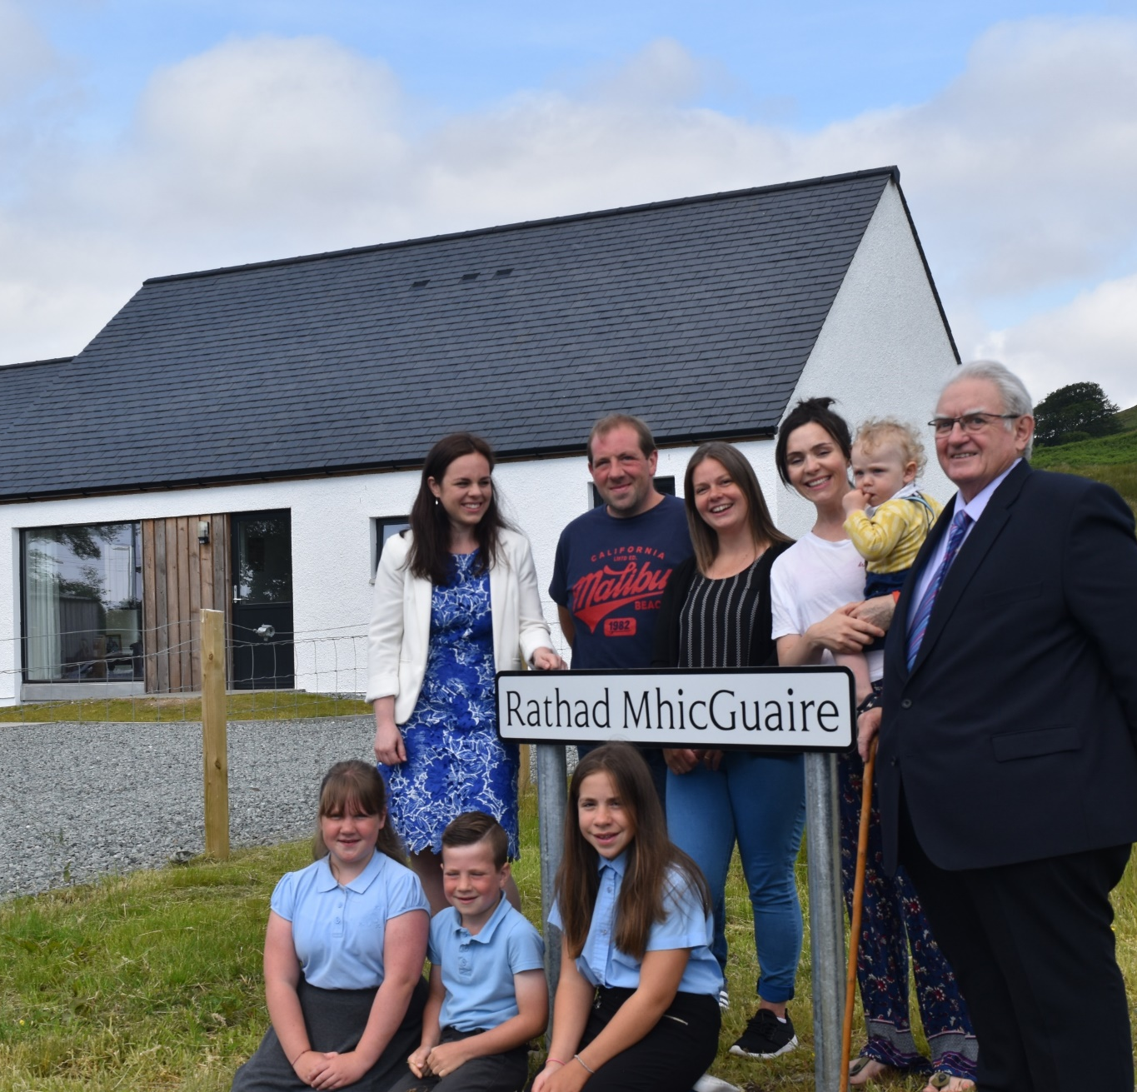
Housing Management
Allocations Policy, Selection of Prospective Tenants / Buyers and Offers.
Ongoing Housing and Tenant Management.
End of Defects Management.
Potential Providers.
Kilbeg, Skye: initial phase of 2
homes with Rural Housing Burden

Slide 8
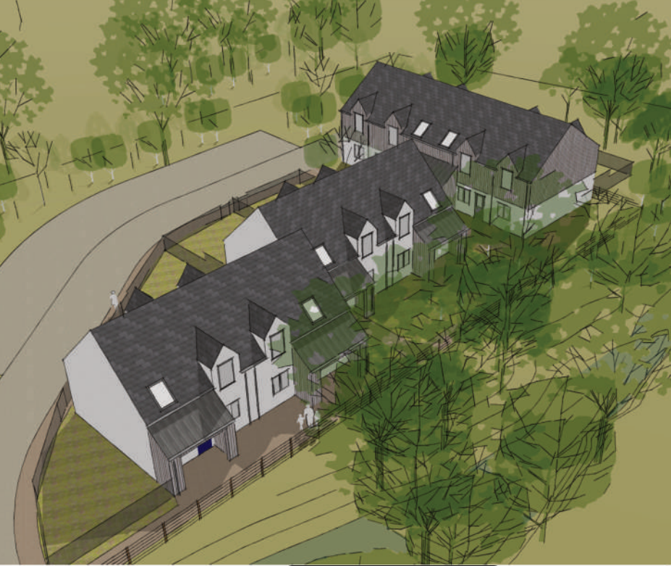
Key Stages
Site Acquisition. Concluded
Statutory Consents. Early 2026
Construction Tender. Summer 2026
Secure Funding. Autumn 2026
Commence Construction. Winter 2026
Handover. Late 2027 / Early 2028

Slide 9



Contact us ​
info@chtrust.co.uk ​01463 233549
www.chtrust.co.uk
@chtscotland
Communities Housing Trust is a Company Limited by Guarantee (SC182862) and a Scottish Charity (SC027544)

